Slide 1


Data-Driven Farming
Unlocking the Potential of Biological Solutions

Slide 2
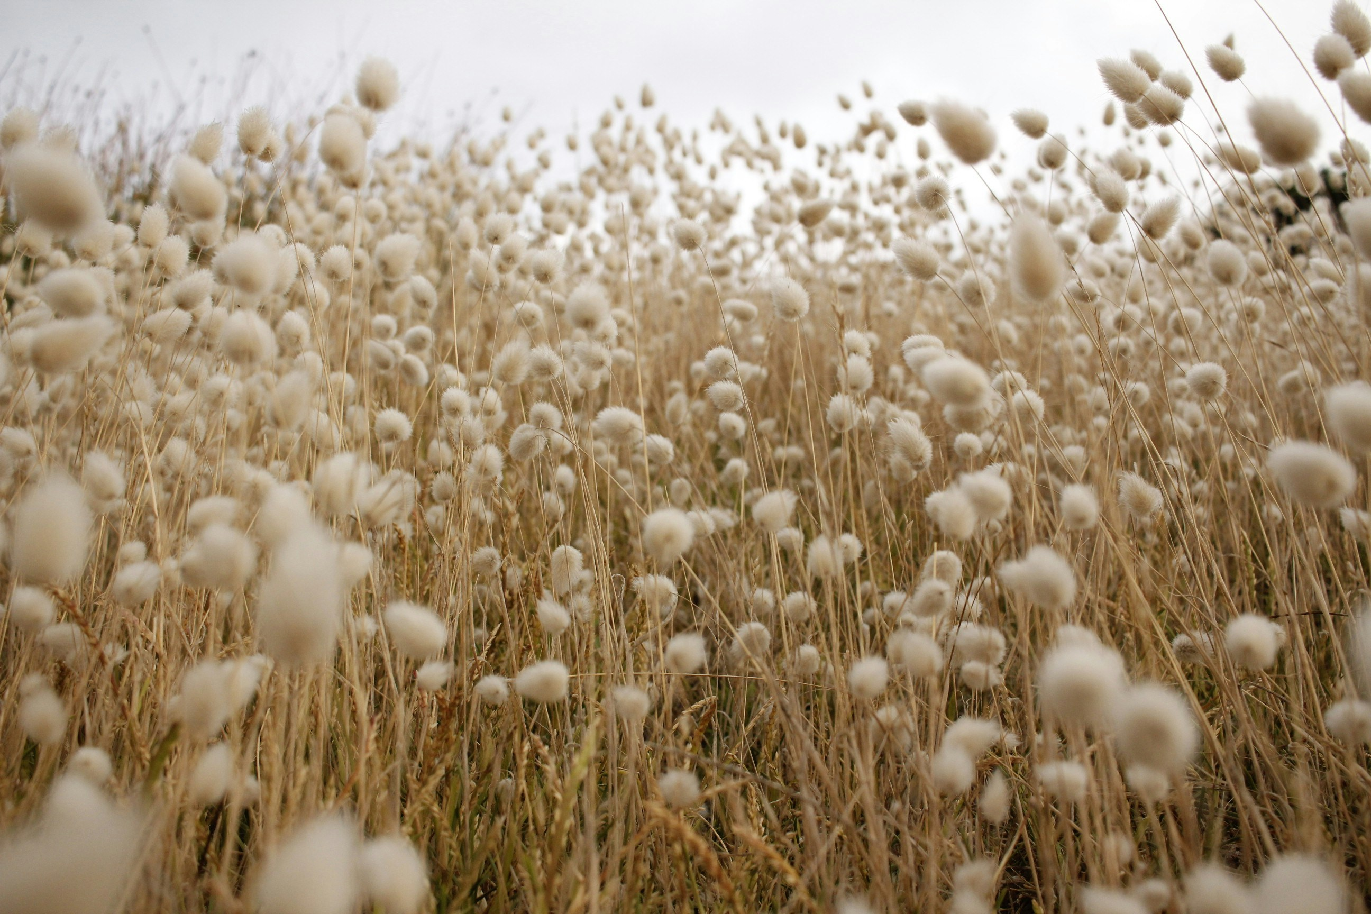
Current Challenges for Indian Farmers
Soil Degradation
Uncertainty in Product Selection
Limited Farmer Awareness
Lack of Feedback Loops

Slide 3

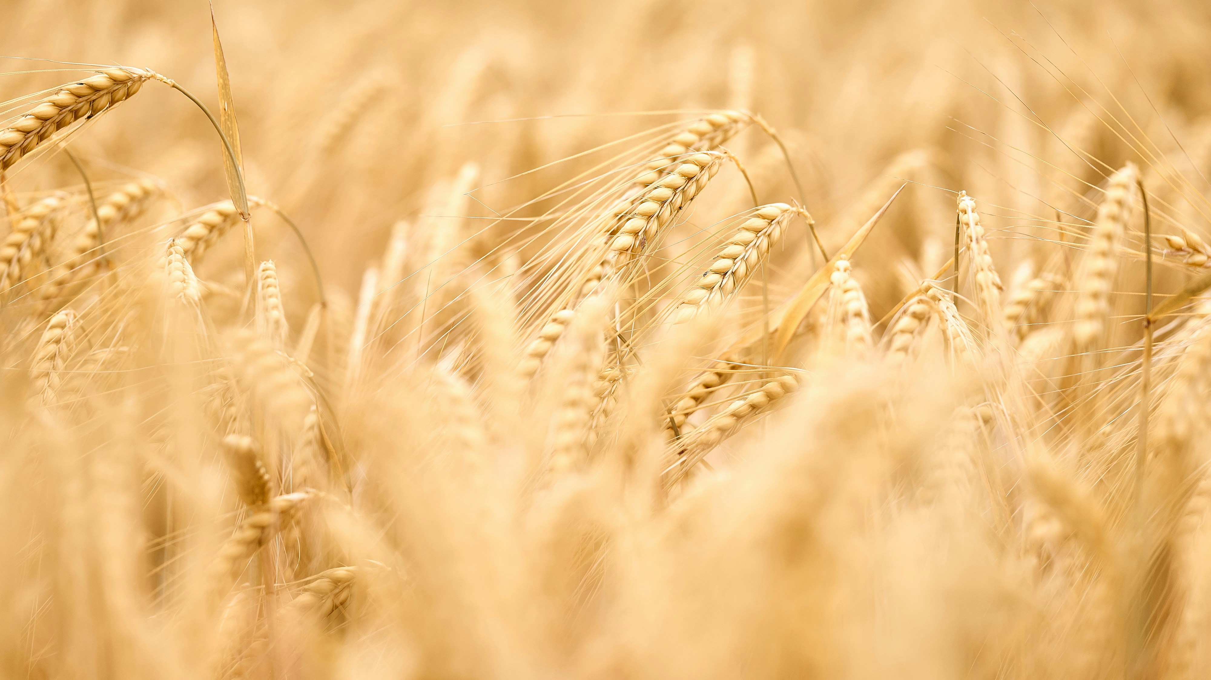
AI-Powered Decision Support
Crop Type
Location
Harvest Season
Initial Risk Assessment and Visualization
Smart Product Recommendation
Performance Tracking & Feedback Loop

Slide 4
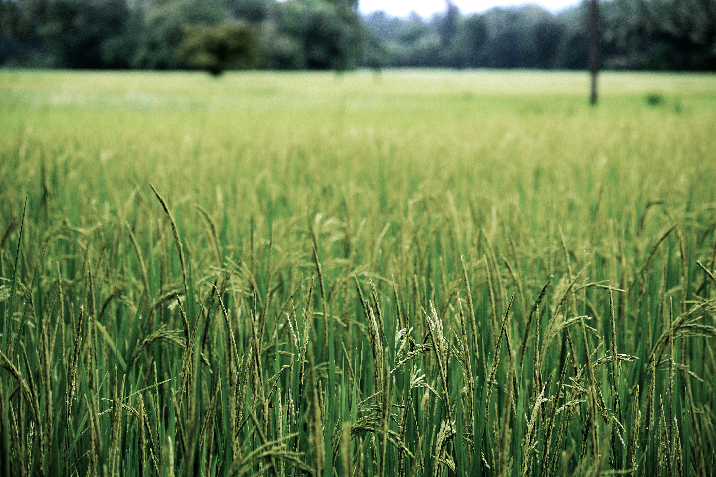
Tailor-Made Solutions
Phase 1
Initial Risk Assessment
Visualization of Risks
Recommendation of Products to use according to growth cycle
AI Chat Support with specific details to farmer
Phase 2
Continuous Risk Assessment
Performance Tracking
Continuous AI Chat Support
Saving of Final Yield of Crop

Slide 5

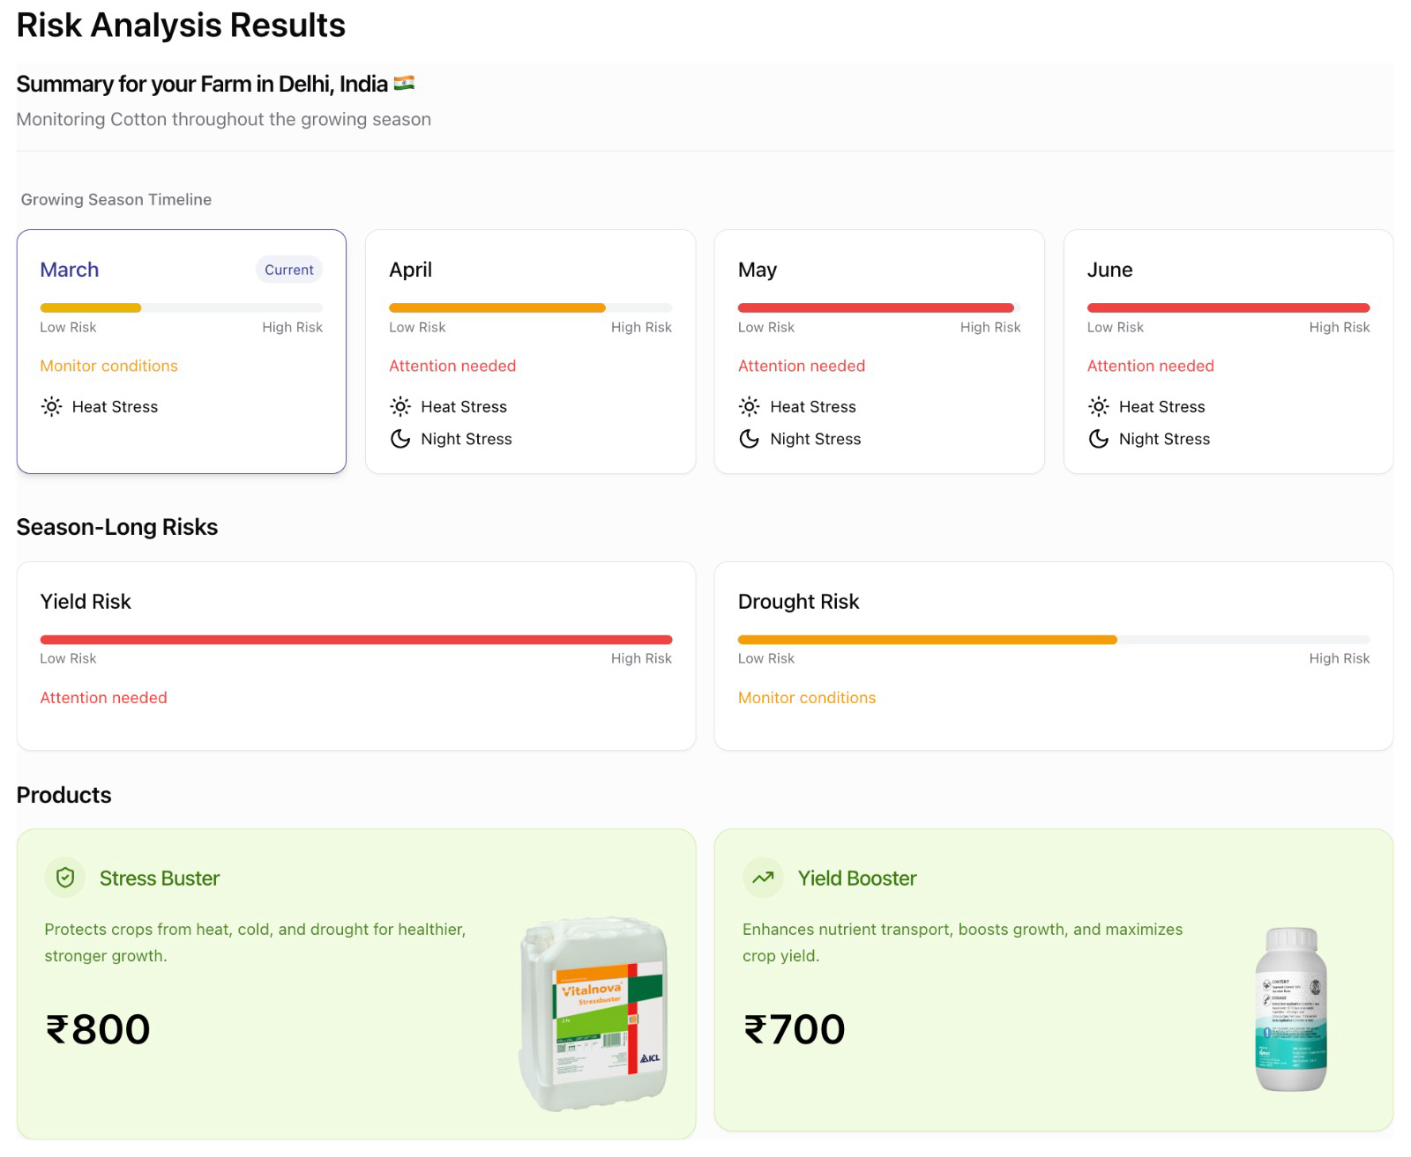
Risk Assessment & Targeted Product Recommendations

Slide 6

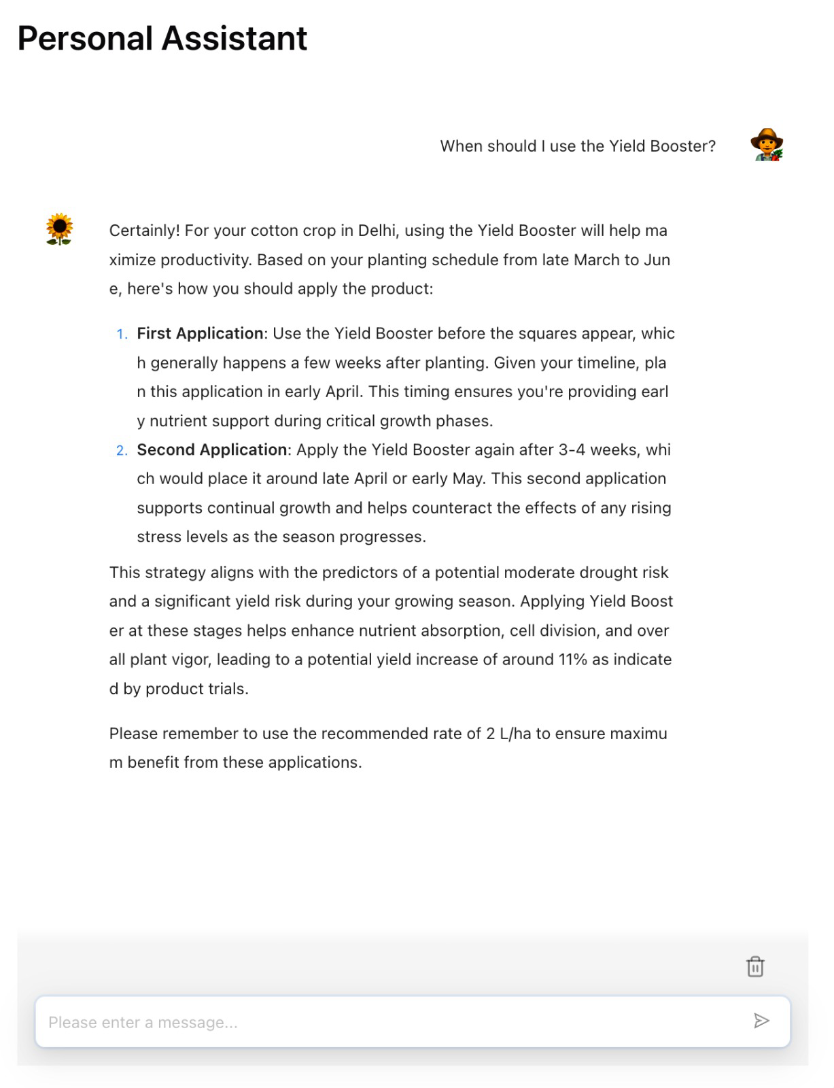
Personalized Guidance from AI Advisor

Slide 7

Feedback
Scheduled feedback call by end of harvest
AI powered Agent

Slide 8
Thank you!

